Slide 1


PUBLIC OPINION ANALYSIS ON PESIDENTIAL ELECTIONS TEAM HAWKEYES HIMA MYTHILI ROUTHULA SHIVANI M RAMESH MEET CHAUHAN YAMINI MAHENDRAN ASHA MOHAN SIDdHARTH GARG
SENTIMENT ANALYIS

Slide 2
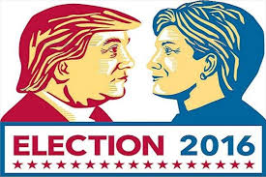
Agenda
Abstract
Introduction
Questions the project seeks to answer
Hypothesis
Data collection and Pre-processing
Experimentation
Analysis on results
Conclusion

Slide 3

ABSTRACT
2016 result anticipation.
Focus What lead to the unanticipated result and what situations worked in favor or against this outcome.
The Study : Tweets on Mr.Trump and Hillary Clinton to analyse the situations which worked in favor of Trump to win 2016 elections and what was the public reaction towards the results.
Our study will not only include the data of previous elections but also the data for coming elections to predict if there is any potential for Hillary to win 2020 elections by studying the recent tweets on 2020 elections.

Slide 4
Introducton
Importance of Social media.
In January 2016, 44% of U.S. adults reported having learned about the 2016 presidential election through social media.
Sharing political thoughts on social media is much easier, and possibly less risky, than posting a sign outside of your house or wearing one-sided clothing.
Growth of fan base by regular posting on social media and by retweeting.

Slide 5
Major findings and key points
The candidates post at similar rates but differ in the focus of these posts and in the attention they receive from the public
Trump stands out for retweeting ordinary people more often than Clinton or Sanders
While Clinton mostly passes on messages crafted by the campaign itself, Trump reaches out to news media and the public.
Both the candidates posted at similar rate of 5-7 times a day on Twitter and 11-12 times a day on facebook.
Public response was almost three times higher for Trump when compared to Clinton.

Slide 6
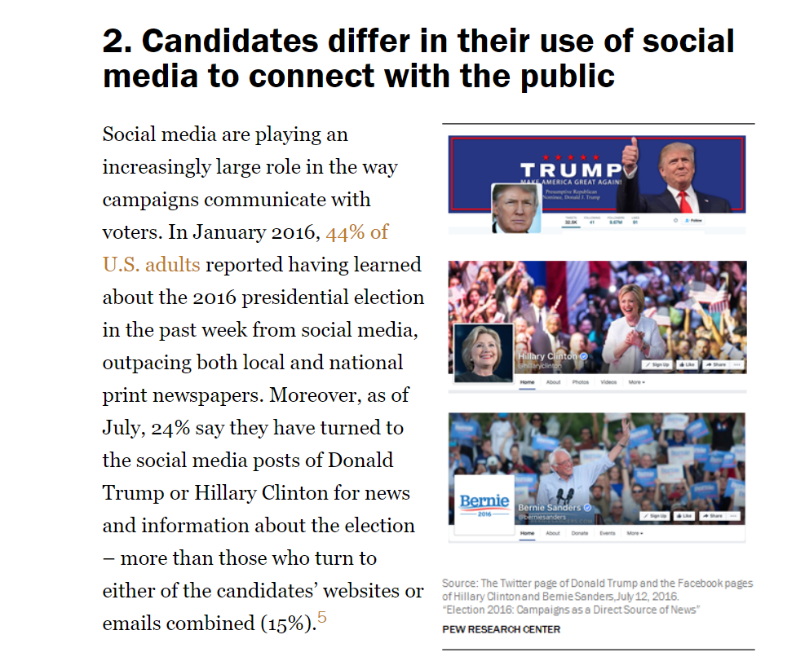
Incidents that made most impact in public:
Sander’s declaration on Twitter that he would debate Trump
Facebook post from Sanders celebrating Native Americans
Trump’s tweet attacking Clinton on gun control
Trump’s Facebook post supporting police
Clinton’s tweet about drought conditions in California
Facebook post was a video attacking Donald Trump

Slide 7
Questions the Project seeks to Answer:
The situations which favoured Trump in his victory
Although Hillary Clinton was a head on competition, what lead to her downfall.
How did social media help in the election campaigning
How did each candidate use this dynamic media to turn the odds in their favour.

Slide 8
Hypothesis
H0: The sentiments or public opinion has direct impact on the election result
H1: The election result is not in accordance with the public sentiments of that region.

Slide 9
Data Collection and Pre-processing
The data has been scrapped from twitter’s API using the following hastags:
#Trump
#election2016
#Hillary
#election 2018
Later we have taken #election2016 with location specified to get data from different locations of the country and to analyse the sentiments in each region.

Slide 10
Text Analysis
Removal of stopwords.
Analysing the wordclouds.
Bag of words we defined: ['b','xe','https','x','xa','twitter','d','sat','nov','co','com','I','status','web', 'en','false','http','realdonaldtrump','download','i','true','hillary’…]
Calculation of sentiment scores.

Slide 11
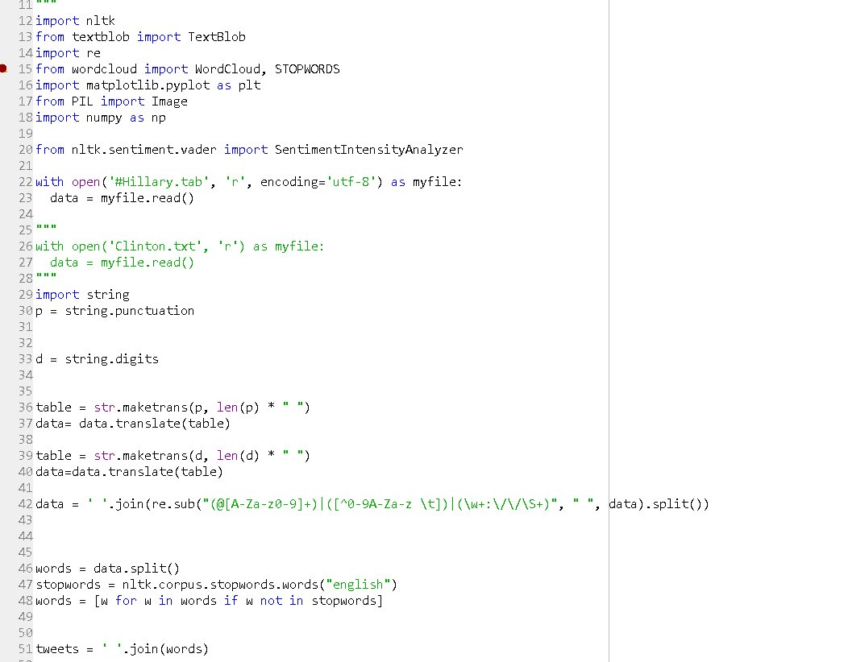
Code snippet

Slide 12
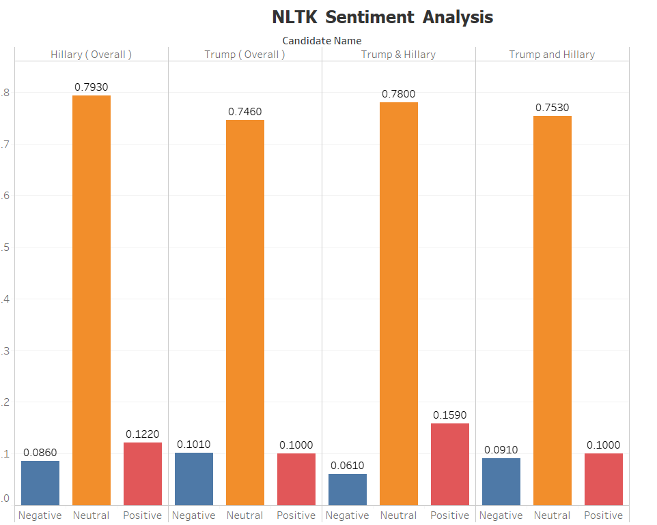

Sentiment Analysis
have used .sentiment function in NLTK to draw the polarity and subjectivity scores

Slide 13
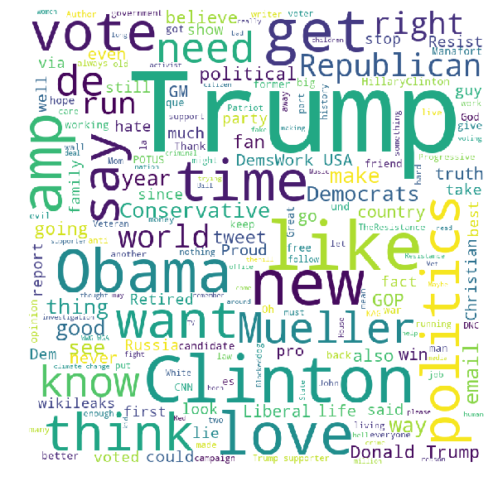
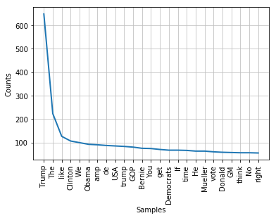
Analysis for #Hillary
Sentiment(polarity=0.07812802414193881, subjectivity=0.46793302962311256)
NLTK Sentiment Analysis
{'neg': 0.086, 'neu': 0.793, 'pos': 0.122, 'compound': 1.0}

Slide 14
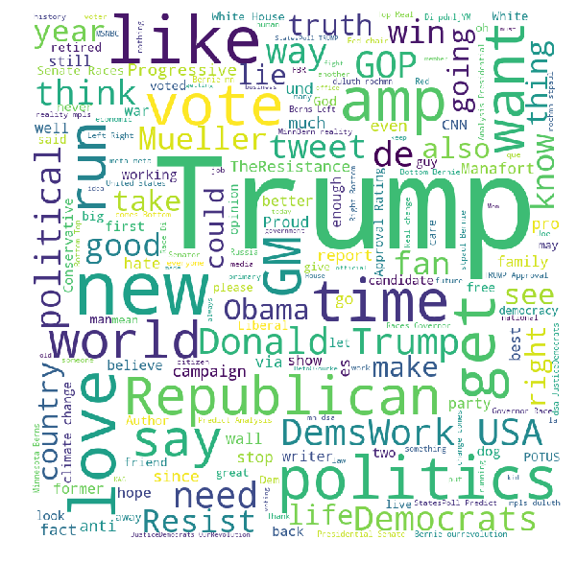
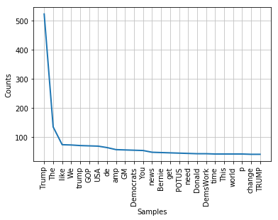
Analysis for #Trump
Sentiment(polarity=0.08861803443311138, subjectivity=0.4519825936997345)
NLTK Sentiment Analysis
{'neg': 0.101, 'neu': 0.746, 'pos': 0.153, 'compound': 1.0}

Slide 15
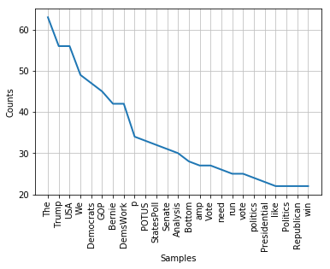
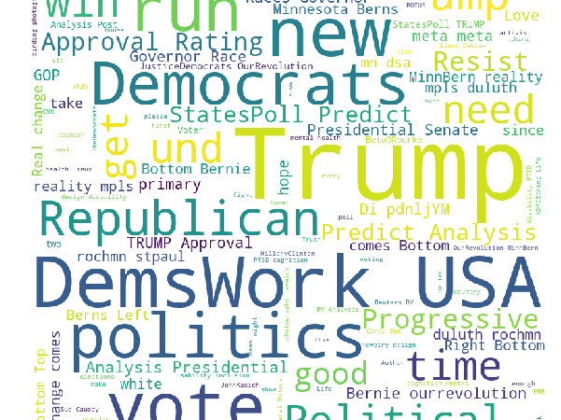
Analysis for #2018_data
Sentiment(polarity=0.11200225690660032, subjectivity=0.4146279811765855)
NLTK Sentiment Analysis
{'neg': 0.061, 'neu': 0.78, 'pos': 0.159, 'compound': 1.0}

Slide 16
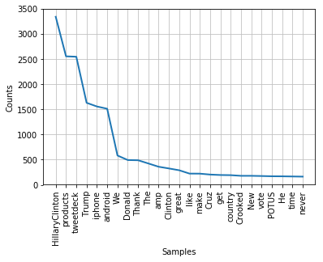
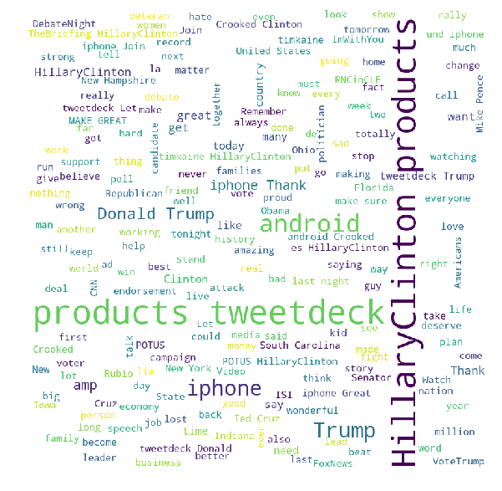
Analysis for #2016_data
Sentiment(polarity=0.14658862589828162, subjectivity=0.513164120625901)
NLTK Sentiment Analysis
{'neg': 0.091, 'neu': 0.753, 'pos': 0.156, 'compound': 1.0}

Slide 17
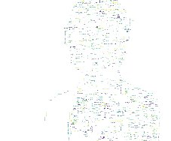
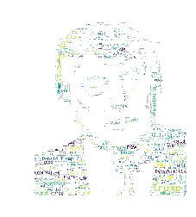
Word clouds masked to the pictures of candidates
We have tried to mask the word clouds with the faces of candidates just create a visual representation.

Slide 18
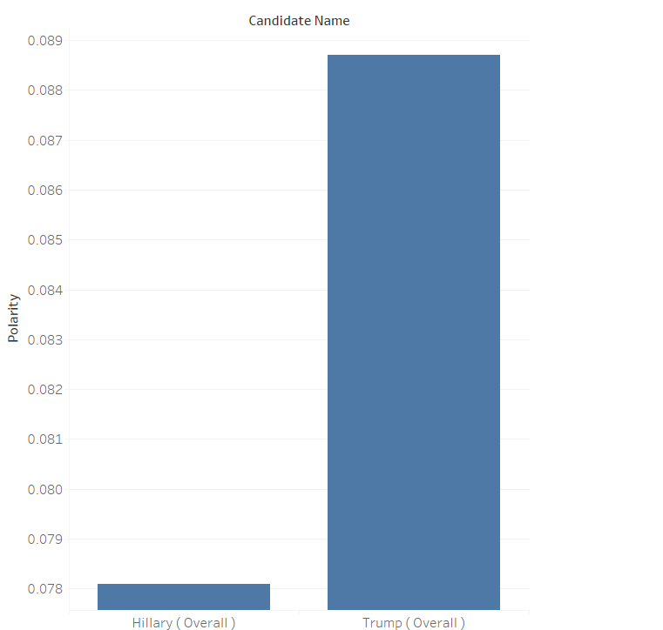
Analysis of the results
Polarity: Closer to 1, it is more positive.
Trump’s polarity : 0.0887
Hillary’s polarity : 0.0781

Slide 19
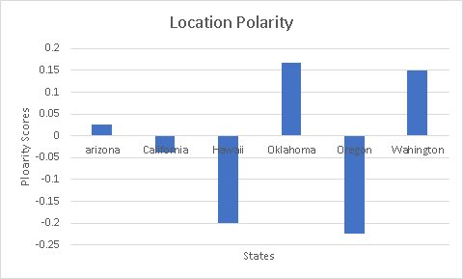
Area wise sentiment analysis
As we can see the sentiment scores in California, Hawaii and Oregon are negative and they correspond with the actual results of 2016 elections.
The results in Arizona , Oklahoma and Washington indicating there are more followers for Trump in those regions.

Slide 20
Conclusion
As we can see in the previous comparison graphs the polarity scores of Trump is much higher than Hillary, our analysis is in accordance with the actual results.
Hence we conclude that the public sentiments have direct impact on the election results and also the social media played a major role in influencing the results.

